Slide 1
The Creation of a Big Data Analysis Environment for Undergraduates in SUNY
Presented by Jim Greenberg
SUNY Oneonta on behalf of the SUNY wide team.

Slide 2
Live Demo of Twitter Text Analysis Done by Undergraduates.

Slide 3
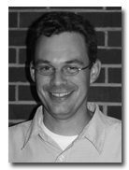
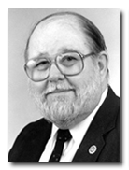
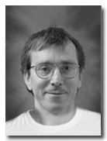
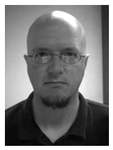
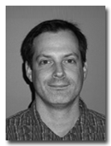
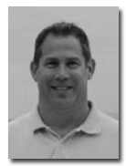
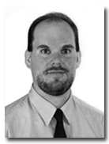
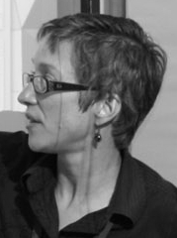
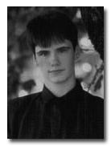
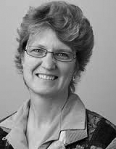
The Team:
Gregory Fulkerson, Ph.D.
Assistant Professor of Sociology
Harry Pence, Ph.D.
Distinguished Professor of Chemistry
James Greenberg
Director, TLTC
Tim Ploss
Instructional Designer
Brett Heindl, Ph.D.
Assistant Professor of Political Science
Bill Wilkerson, Ph.D.
Associate Professor of Political Science
Achim Koeddermann, Ph.D.
Associate Professor of Philosophy and Env. Sciences
Steven M. Gallo
Lead Software Engineer
CCR, University at Buffalo
Brian M. Lowe, Ph.D.
Associate Professor of Sociology
Jeanette Sperhac
Scientific Programmer
CCR, University at Buffalo
Diana Moseman
Instructional Designer/Programmer TLTC
Lisa Stephens
Senior Strategist for Academic Innovation, SUNY Office of the Provost

Slide 4
Adopting social media analysis at SUNY – Genesis of Idea
Social Sciences approached IT at SUNY Oneonta to build an analysis environment
The needed resources did not exist at PUI
SUNY Oneonta connected with U of Buffalo’s CCR

Slide 5
Collaboration Goals
Create a social sciences big data discovery environment
Support social science teaching and research
Leverage High Performance Computing (HPC) resources
Support coursework at Oneonta, Spring 2014
Expand to SUNY Summer 2014 and beyond

Slide 6
Introducing VIDIA
Virtual Infrastructure
for Data Intensive Analysis

Slide 7
VIDIA
Deployed using Purdue's HUBzero platform:
Provide workflow tools for data analysis
Offer access to computing resources
Curate large datasets of social scientific interest

Slide 8
Data Mining Workflow Tools
Graphical User Interface
Powerful, easy to use
Open source, extensible

Slide 9
Dataset Access
Curate Big Data for social science:
Social data: Twitter feeds, etc.
Partnerships with social dataset providers
Enable students to capture own data

Slide 10
HUBzero Platform
Open source platform offers:
Access via web browser
Computation, collaboration, software tool development
Simplified access to remote HPC resources
Upload and sharing of course materials
And more...

Slide 12
Teaching on HUBzero
Unified platform for coursework
Easy on IT staff:
Obviates software installs on individual student workstations
Access anytime, anywhere
Resources can be selectively secured
Students may access resources after course conclusion

Slide 13
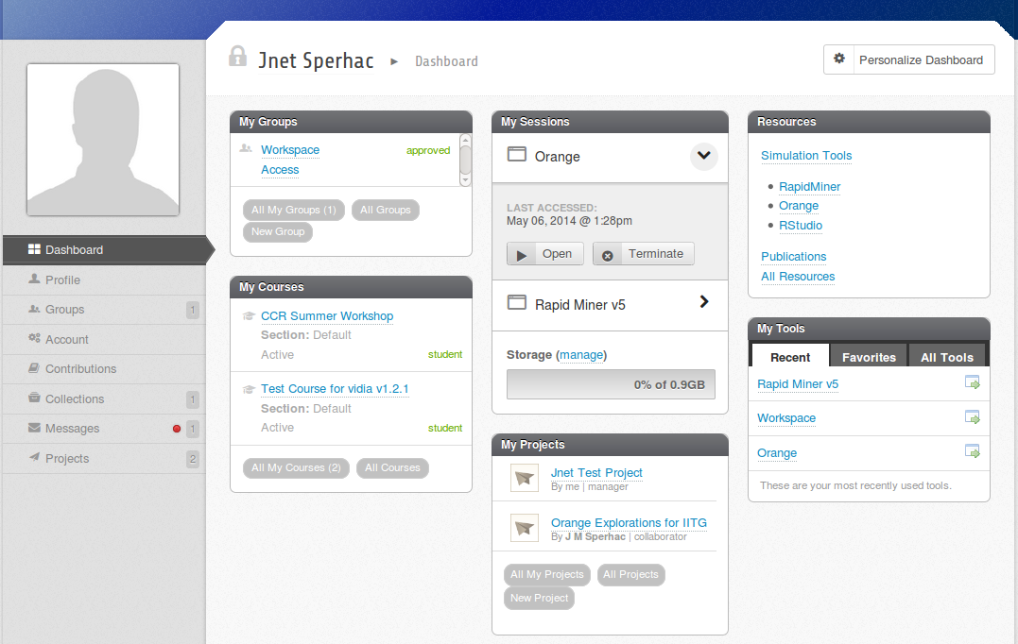
User Dashboard

Slide 14
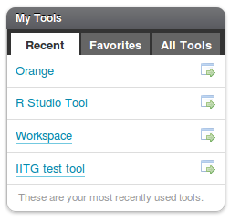
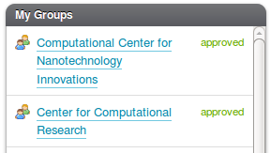
Collaborative Features
Any registered user can manage and control access to their own:
Groups: assemble users with common interests
Projects: assemble resources for a common goal
Tools: development, deployment, simulations

Slide 15
Groups
HUBzero groups can:
Control access to resources
Share and distribute content
Allow users with common interests to associate
Any registered user may create a group

Slide 16
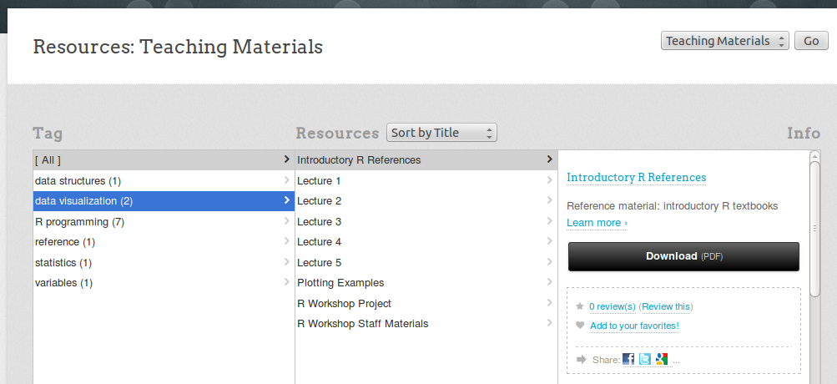
Resources

Slide 17
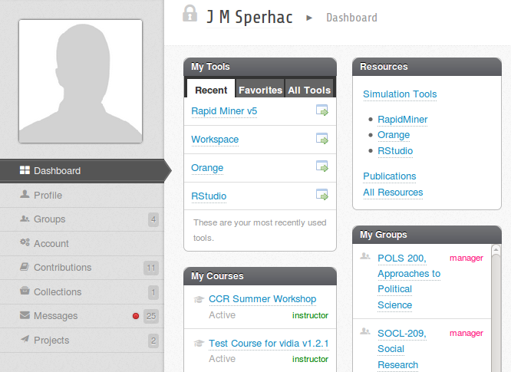
Deployed Tool
Orange Data Mining Tool

Slide 18
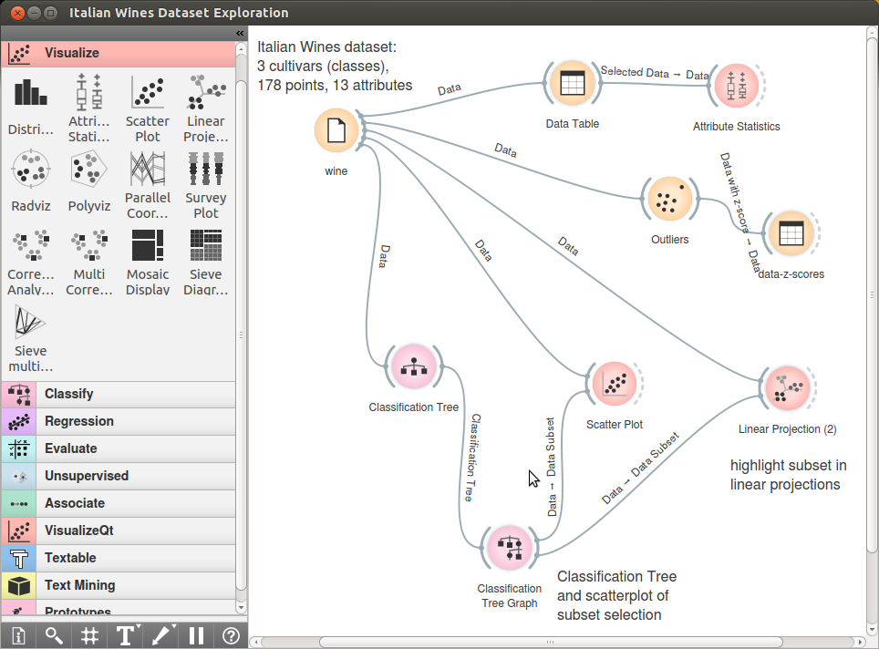
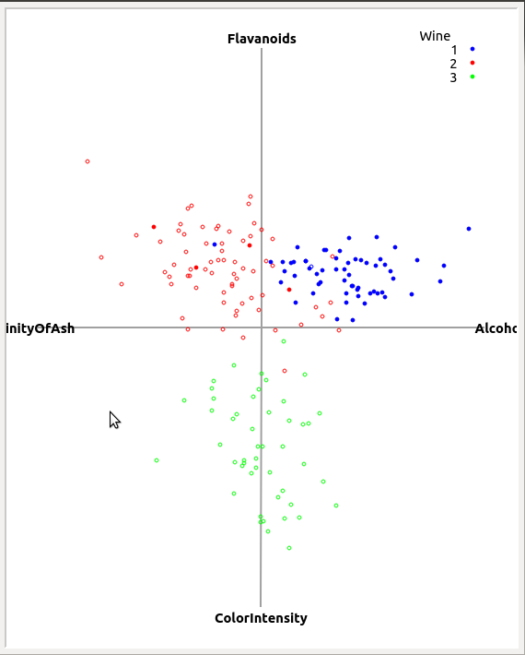
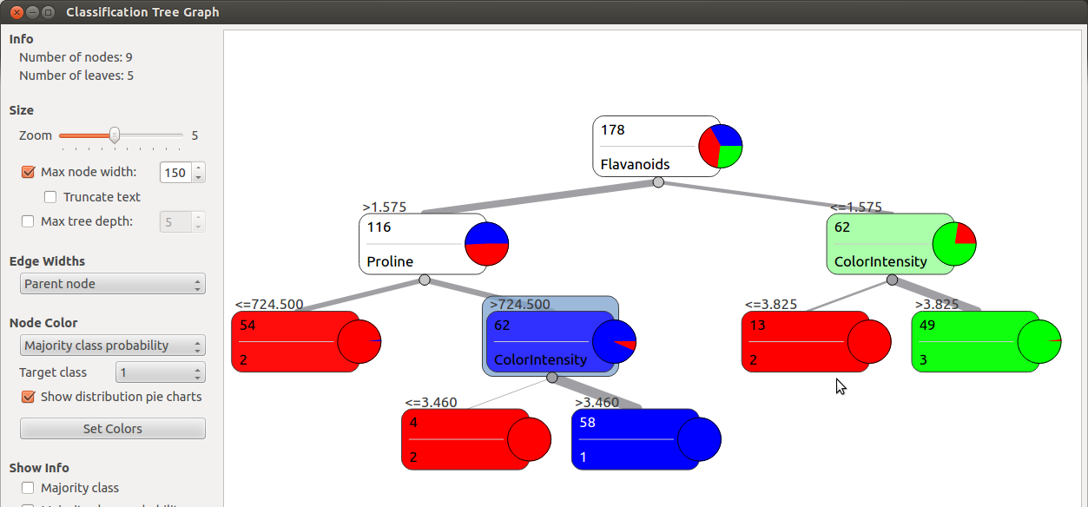

Slide 19
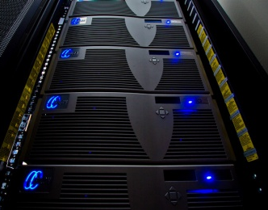
Computing Environment
Cluster
resources
HUBzero server
User's Workstation
(web browser)
Data storage

Slide 20
VIDIA Hardware
HUBzero and webserver: Dell PowerEdge R720xd
2x 6-core Intel Xeon E5-2630 (2.30 GHz, 15M cache)
48 TB raw (~36 TB usable) SATA disk space
128 GB memory (16x8GB - 1333MHz DIMMS)
Analysis: 4x Dell PowerEdge R520
6-core Intel Xeon E5-2430 (2.20 GHz, 15M cache)
4.8 TB raw (~4 TB usable) SAS disk space
96 GB memory (6x16GB - 1600MHz DIMMS)

Slide 21
VIDIA: Spring 2014
Supported three SUNY Oneonta courses
Deployed three data analysis tools
76 student users registered (themselves!)
Assigned student tasks:
k-Means Clustering
Word Co-Occurrences
Enabled 25+ simultaneous tool sessions

Slide 22
RapidMiner Sessions
on VIDIA
Month | Tool Users | Tool Sessions Run | Tool Walltime | Tool CPU Time
April 2014 | 77 | 568 | 41.7 days | 21.7 hours
May 2014 (as of 8 May) | 80 | 849 | 61.0 days | 23.7 hours

Slide 23
Challenges
User training: learning the platform and tools
Technical performance details
HUBzero updates
Browser compatibility
Dataset acquisition

Slide 24
What's next?
SUNY Oneonta coursework, Fall 2014
Deploy additional data mining tools
Integrate HUBzero collaboration features
Roll out to other SUNY comprehensive colleges (Discussion underway with SUNY Brockport)
Support individual SUNY faculty research

